Slide 1
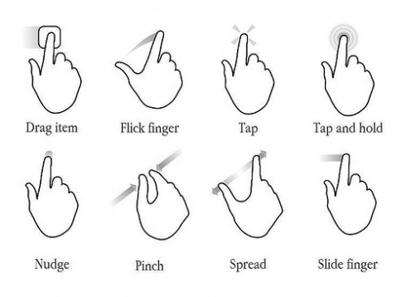


Gesture password
Android study

Slide 2
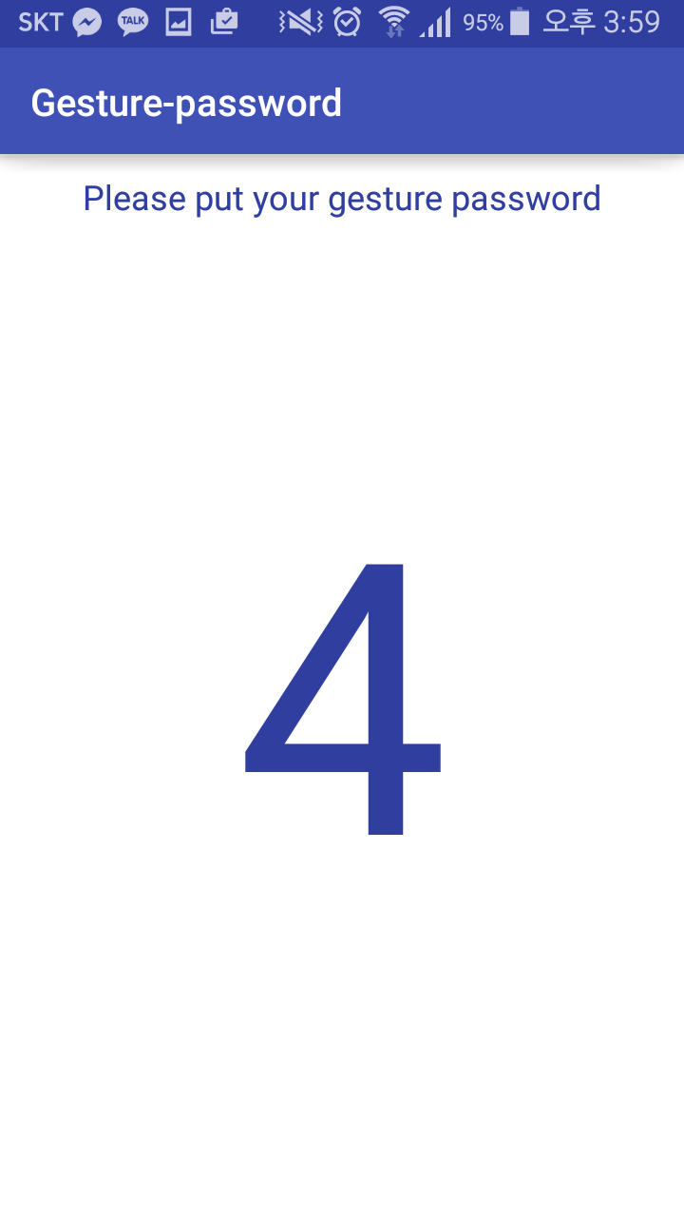
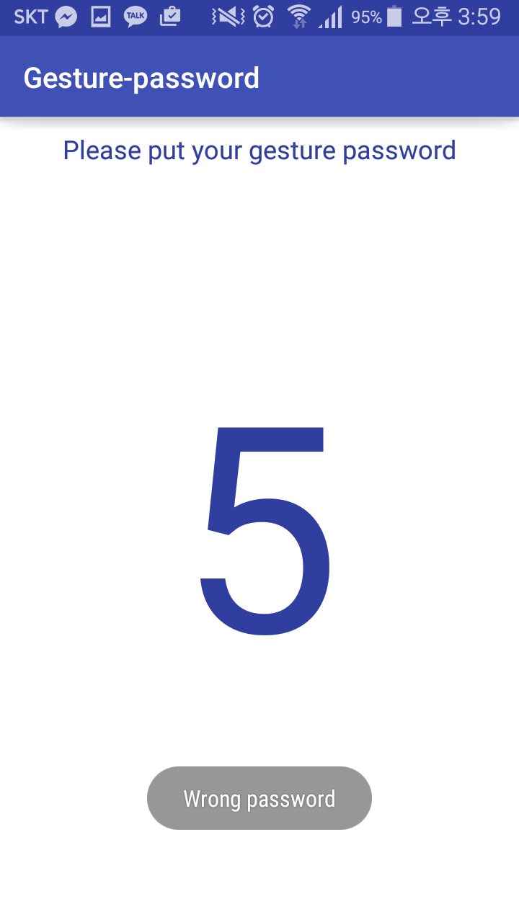
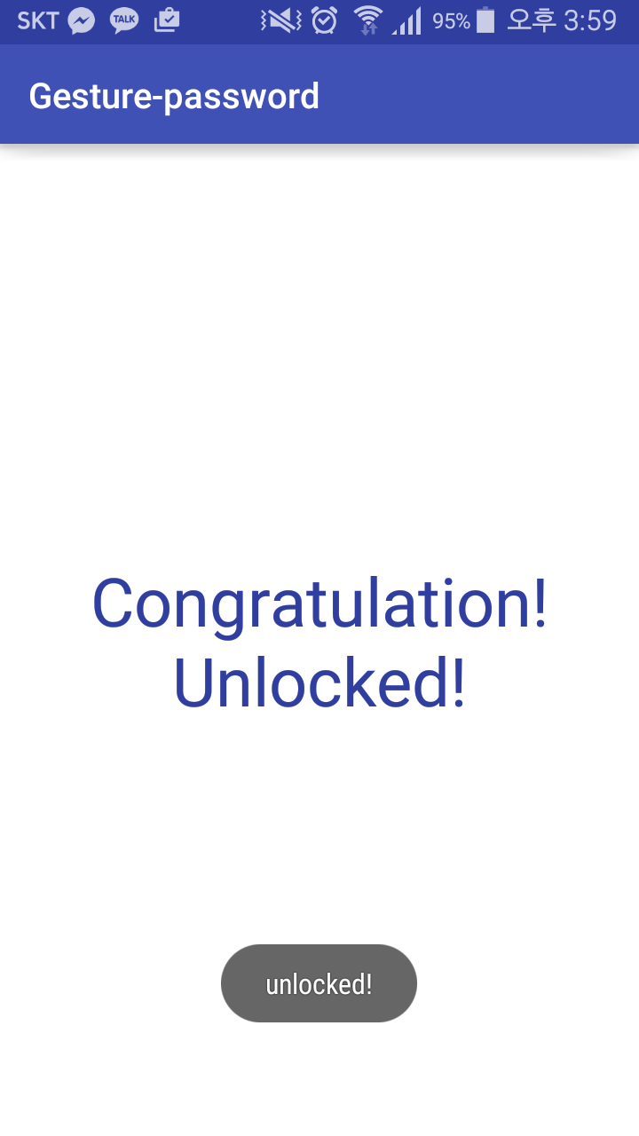
Goal

Slide 3
Review

Slide 4

Inheritance
Parent Class
Child Class
Give his method, variables…
Child Class
Parent Class
onCreate
setContentView
findViewById
getSystemService
onResume
onPause
ActionBar
…
onCreate
setContentView
findViewById
getSystemService
onResume
onPause
ActionBar
…

Slide 5
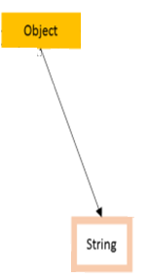
Override
Parent Class : Object
equals()
Child Class : String
@Overriding
equals()
Changing parent class’ method

Slide 6
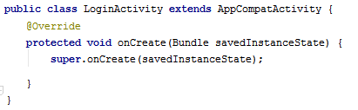
onCreate()
Like main() method in ordinary java

Slide 7

Callback method
Event occurs > Listener response > correspond callback method is called
View class
interface
callback method
Mom: Chulsu, Please come back home by PM 6:00
What time is it now?
It’s 4:00
It’s 4:30
It’s 4:38
It’s 5:01
Please don’t ask me again ☹

Slide 8

Callback method
Event occurs > Listener response > correspond callback method is called
View class
interface
callback method
Mom: Chulsu, Please come back home by PM 6:00
Please tell me at PM 6:00
OK~☺
event
callback method

Slide 9
Nested class

Slide 10
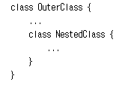
The Java programming language allows you to define a class within another class. Such a class is called a nested class and is illustrated here:
-It is a way of logically grouping classes that are only used in one place
-It increases encapsulation
-It can lead to more readable and maintainable code

Slide 11
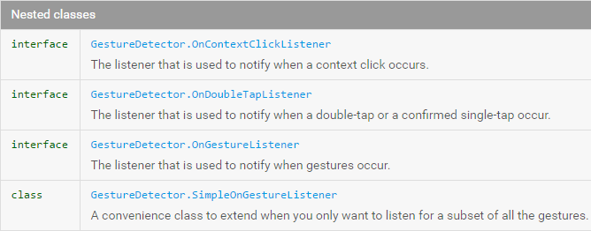

Slide 12
GestureDetector

Slide 13
Constructor of GestureDetector class
; Get gesture information
GestureDetector
(Context context, GestureDetector.OnGestureListener listener)

Slide 14
Method of GestureDetector class
onTouchEvent(MotionEvent ev)
onGenericMotionEvent(MotionEvent ev)
setContextClickListener(GestureDetector.OnContextClickListener onContextClickListener) setOnDoubleTapListener(GestureDetector.OnDoubleTapListener onDoubleTapListener)

Slide 15

onTouchEvent(MotionEvent ev)
Analyzes the given motion event and if applicable triggers the appropriate callbacks on the GestureDetector.OnGestureListener supplied.

Slide 16
onTouchEvent(MotionEvent ev)
It is also in our Parent Class “Activity”

Slide 17
OnGestureListener

Slide 18
Method of OnGestureListener interface
onDown(MotionEvent e)
onFling(MotionEvent e1, MotionEvent e2, float velocityX, float velocityY)
onLongPress(MotionEvent e)
onScroll(MotionEvent e1, MotionEvent e2, float distanceX, float distanceY)
onShowPress(MotionEvent e)
onSingleTapUp(MotionEvent e)

Slide 19
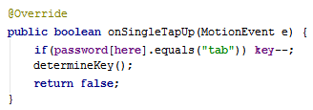

onSingleTapUp(MotionEvent e)
When up

Slide 20

onShowPress(MotionEvent e)
This press down state,
Not tap up

Slide 21
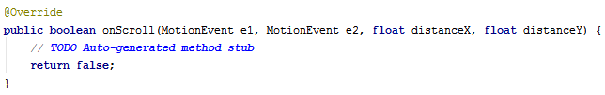
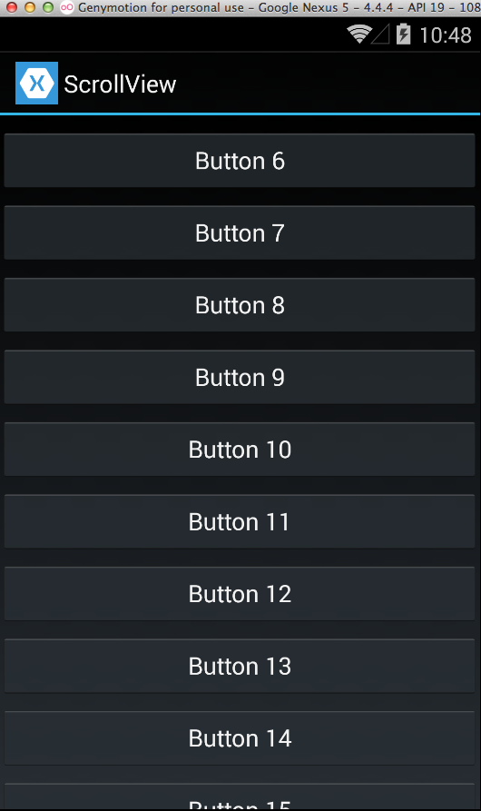
onScroll
(MotionEvent e1, MotionEvent e2, float distanceX, float distanceY)

Slide 22
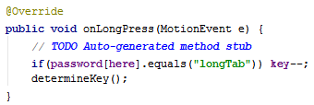
onLongPress(MotionEvent e)

Slide 23
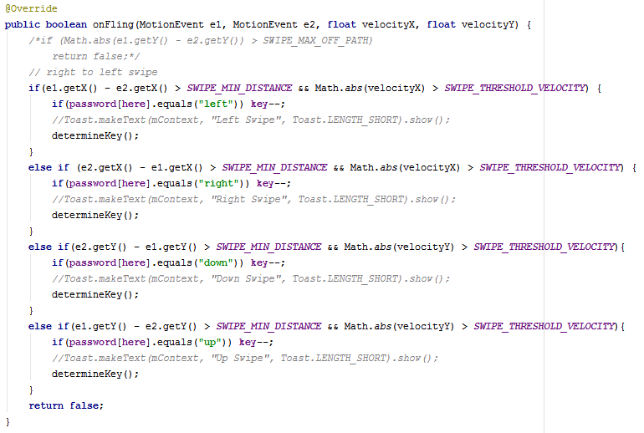
onFling
(MotionEvent e1, MotionEvent e2, float velocityX, float velocityY)
e1
e2

Slide 24

onDown(MotionEvent e)
When down

Slide 25
MotionEvent

Slide 26
MotionEvent class
Motion events describe movements in terms of an action code and a set of axis values.
Method of MotionEvent class
getX()
getY()
getSource() getPressure()
getDownTime()
+
0
+

Slide 28
Math

Slide 29
Method of Math class
abs(int[double/long/float] a)
acos(double a)
random()
copySign(float magnitude, float sign)
min(int[double/long/float] a,int[double/long/float] a)
max(int[double/long/float] a,int[double/long/float] a)

Slide 30

Download skeleton
https://github.com/daehwa/world-friends-Uzbekistan-android/

